Slide 1
03.25 Meeting - 24
吳定洋
1

Slide 2
Table of contents
01
Experimental Procedure
02
Data distribution observation
03
Future Work
2

Slide 3
為了開始寫introduction 部分，整理之前所有實驗流程
在某些 RP 的所有測試資料中，發現平均 MDE 偏高的主要原因，可能是因為某次定位失敗時，預測結果被錯誤地定位到非常遙遠的 RP (例如該次預測錯誤的 MDE 為 6m)，導致整體誤差拉大。因此，想要透過觀察數據的分布情況，看能否找出一種較通用的方法來降低 MDE，確保即使定位失敗，預測結果與實際位置的誤差仍然不會過大。
3

Slide 4
All Experimental Procedure
4

Slide 5
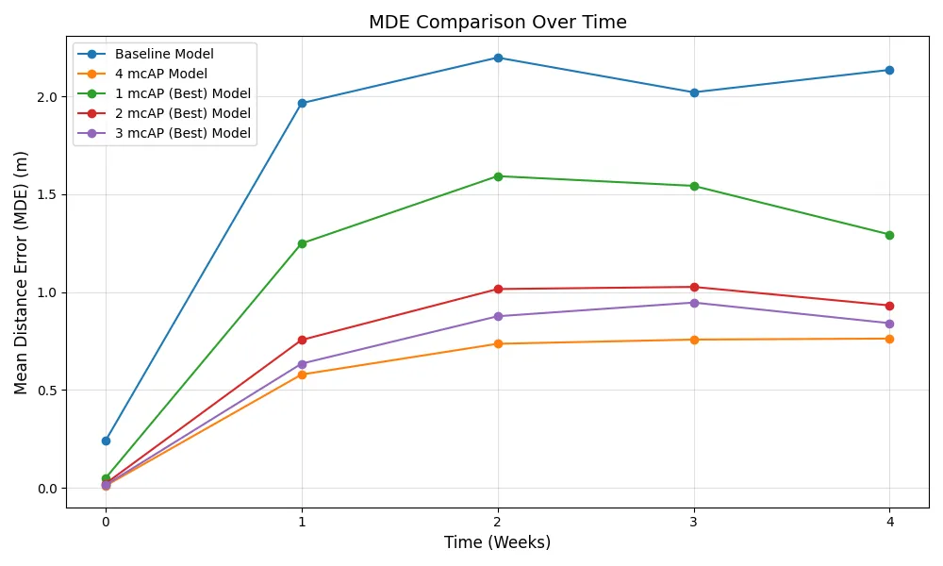
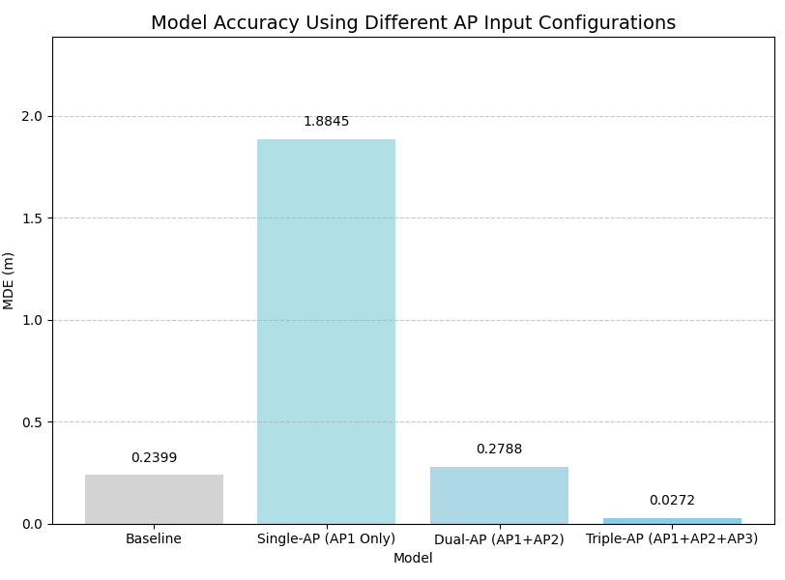
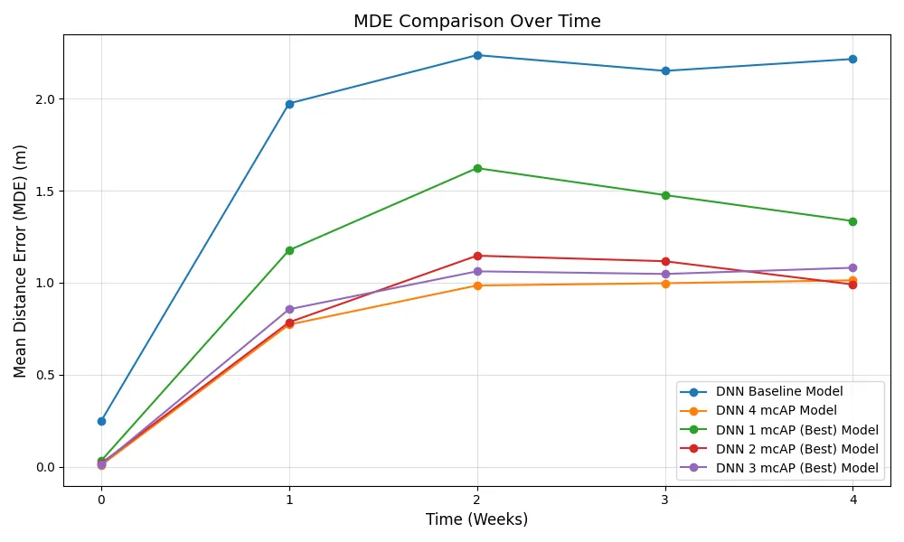
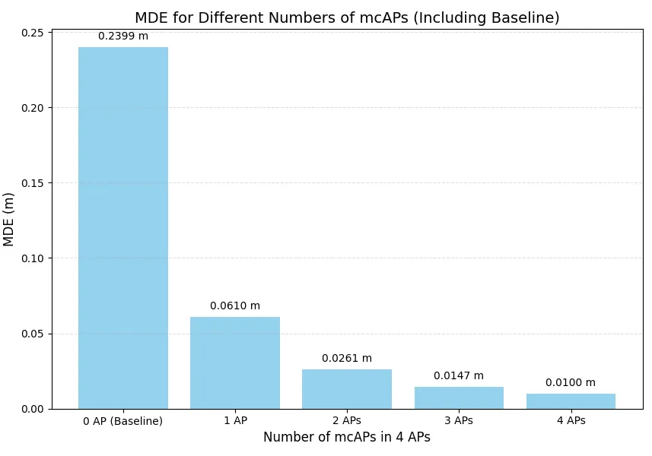
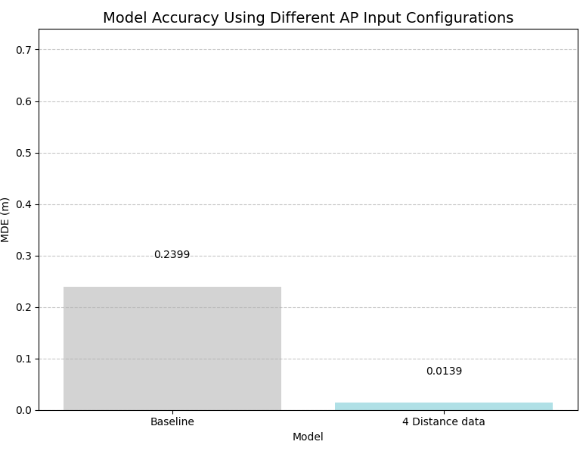
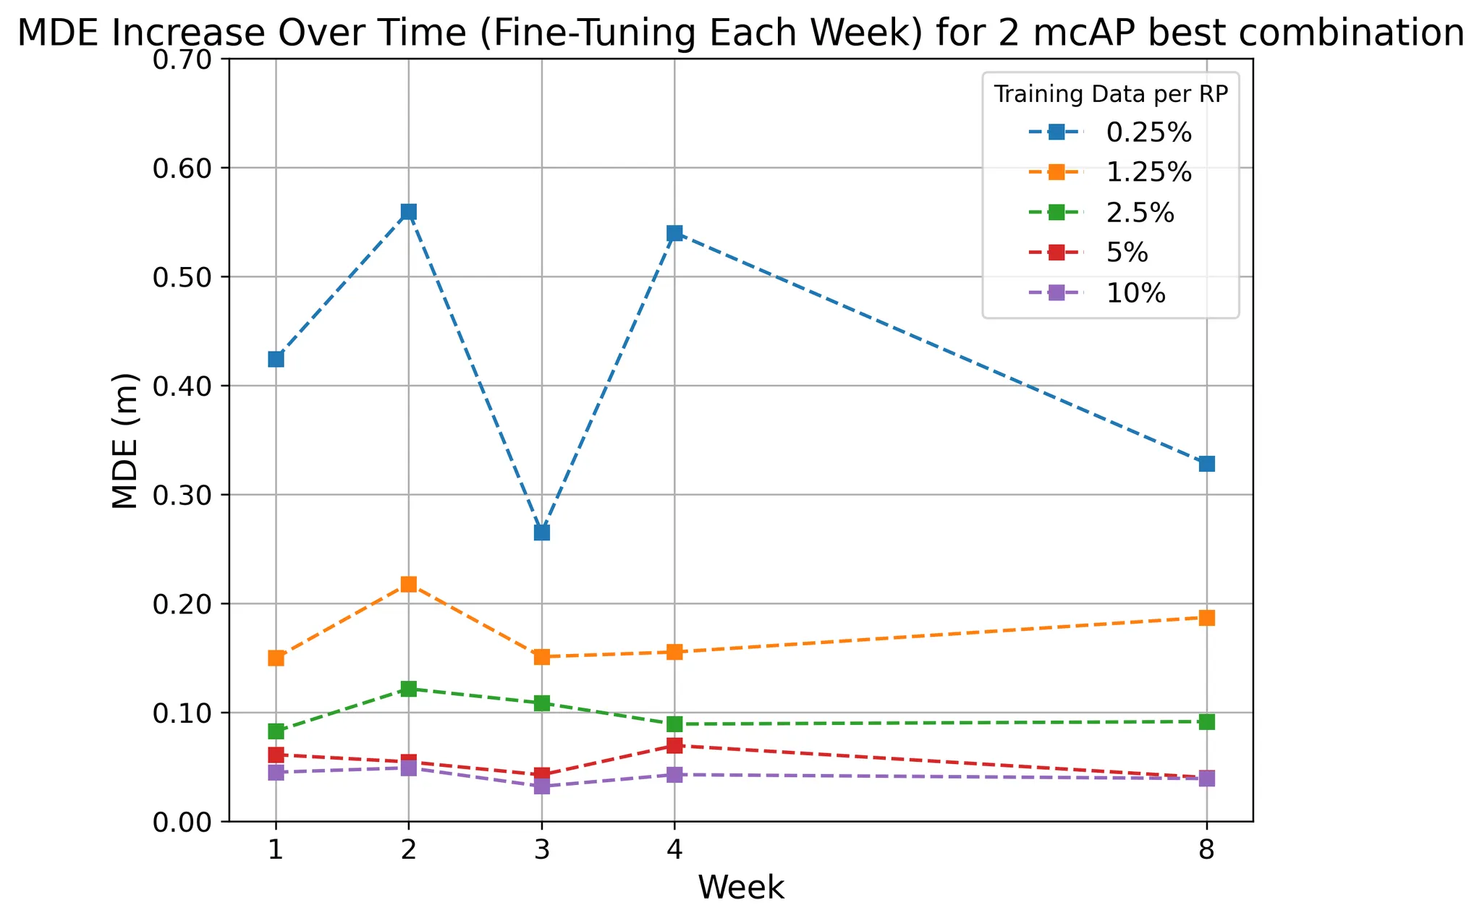
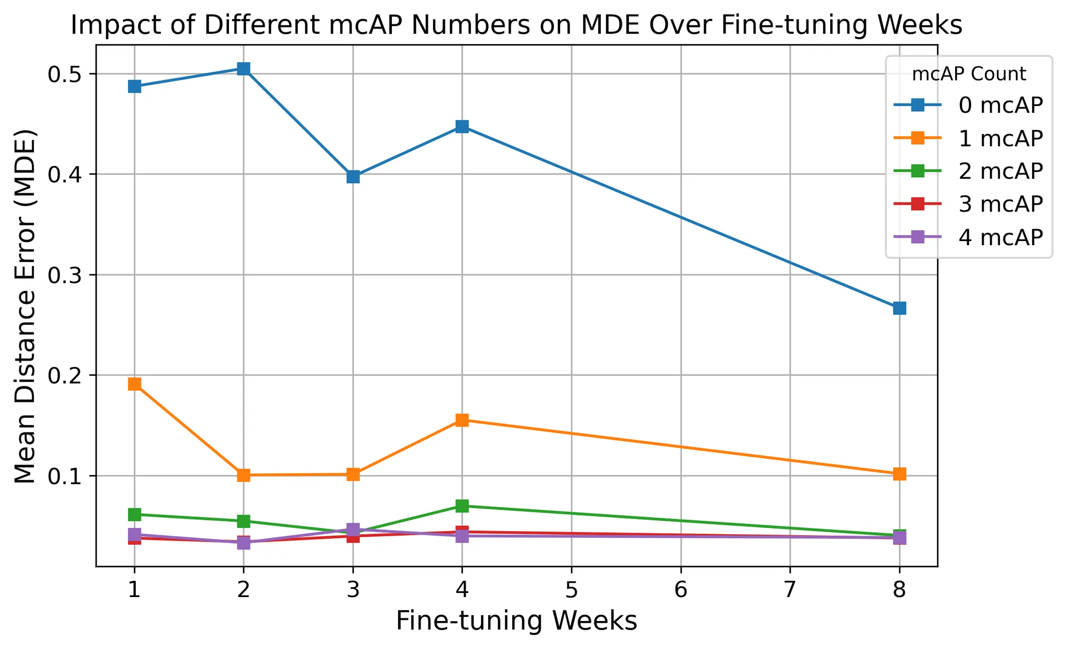
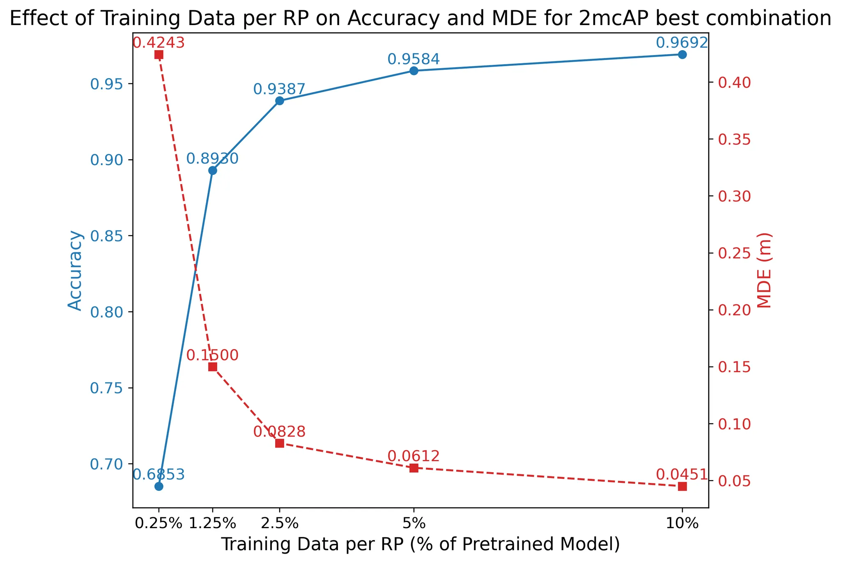
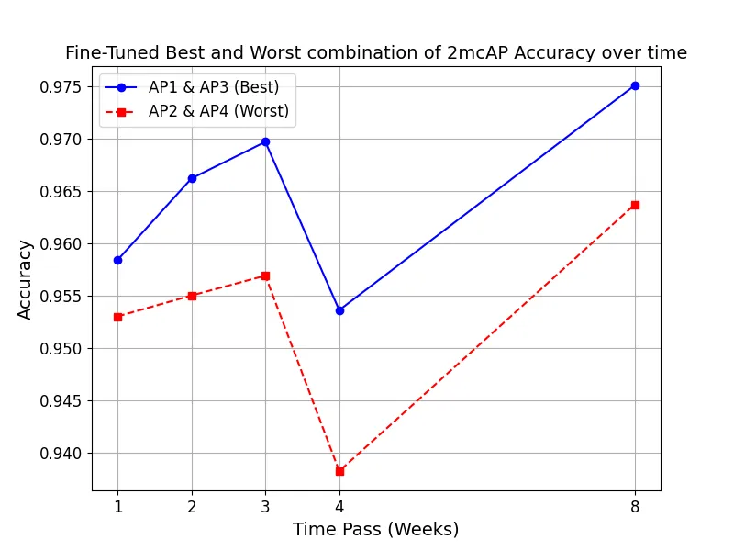
目前所有實驗
Using KNN model to discuss
Using DNN model to discuss
Compare the accuracy differences in positioning models using the fingerprinting method between RSSI data and RTT data.
Observe the accuracy changes of the models (5 models below) over time from the previous experiment
Baseline
1 mcAP(Best)
2 mcAP(Best)
3 mcAP(Best)
4 mcAP
Switch to a DNN model to evaluate its performance, including weekly accuracy, accuracy degradation over time without fine-tuning, the extent to which fine-tuning mitigates degradation, and the optimal amount of data for fine-tuning. Experiments include
5 different models (previous block)
How well does the DNN model perform? (Based on weekly accuracy)
How does the DNN model degrade over time? (Without fine-tuning)
Determine the minimum number of mcAPs required to achieve the same positioning accuracy as the baseline model (using only RSSI)
How much new data is needed for effective fine-tuning?
Explore how upgrading a few of the four existing APs to mcAPs (FTM-supported) improves positioning accuracy and quantify the accuracy gain based on different numbers of upgraded mcAPs.
What is the impact of different mcAP configurations? (5 different scenario)
5

Slide 6
AP1_distance | AP2_distance
Block 2 :
Block 3 :
AP1_Rssi | AP2_Rssi | AP3_Rssi | AP4_Rssi | AP1_distance | AP2_distance
6

Slide 7
Data distribution observation
7

Slide 8
Motivation
Observe all data distribution for 49 RPs to find a more general method to reduce MDE, so that even if positioning fails, the error won't be too large.
In some RP's test data, the main reason for the high average MDE may be that, in cases of positioning failure, the predicted result is mistakenly assigned to a very distant RP (e.g., the MDE of that incorrect prediction is 6m), which significantly increases the overall error.
8

Slide 9
Under the condition that the data splitting method remains exactly the same, the model was trained 5 times.
 | 1 | 2 | 3 | 4 | 5
MDE | 0.0077 | 0.0103 | 0.0113 | 0.0171 | 0.0147
Accuracy | 99.40% | 99.32% | 99.34% | 99.12% | 99.04%
MDE and accuracy of the five training runs
9

Slide 10
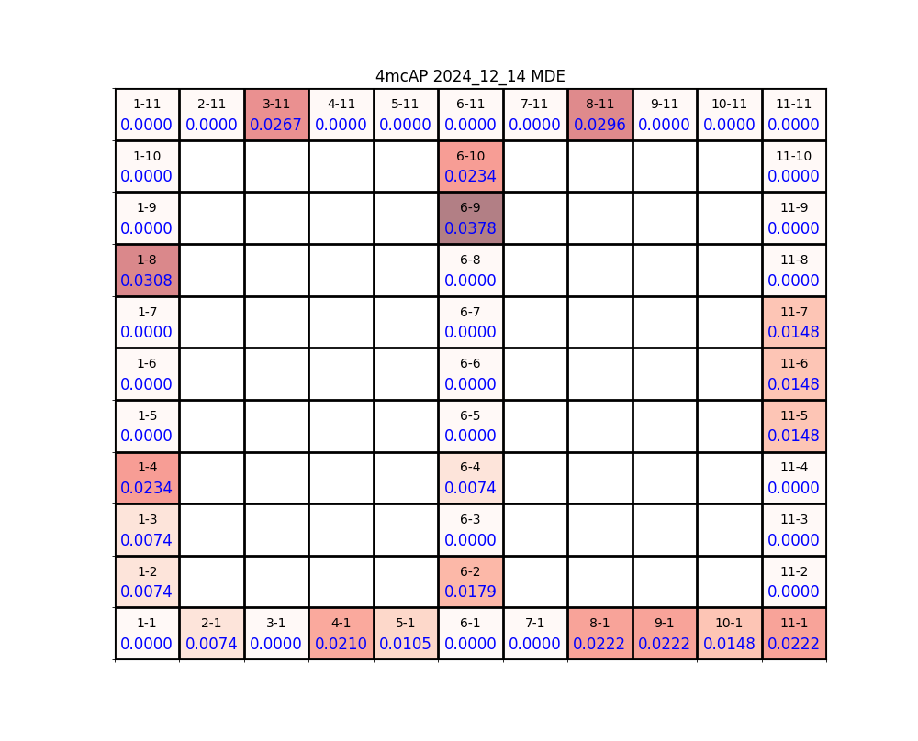
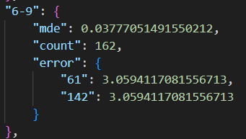
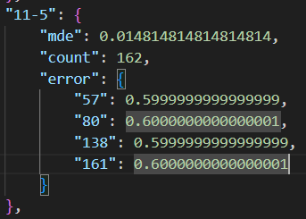
Accuracy: 97.53%
10

Slide 11
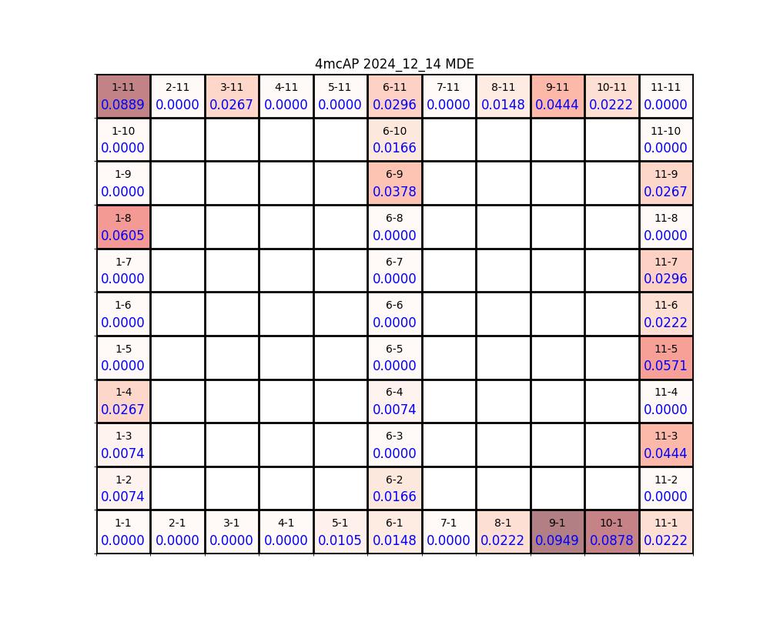
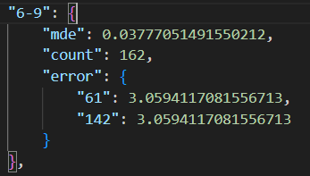
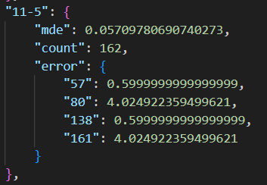
Accuracy: 97.53%
Accuracy: 97.53%
11

Slide 12
Discover
locations of AP3 and AP4 on the previously marked map were swapped.
As a result, in the previous experiments, the improvements observed in different mcAP combinations for the positioning model need to be adjusted by swapping AP3 and AP4.
By analyzing the data distribution, it can be observed that outliers occasionally appear, which may be the reason why MDE is higher when prediction errors occur.
12

Slide 13
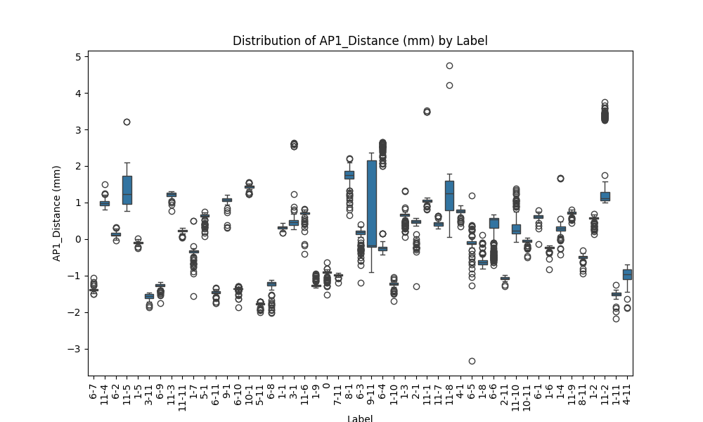
Similarly, split all the features into training and testing data, and plot them to observe.
13

Slide 14
Future Work
14

Slide 15
Question :
DNN model 能否訓練到不同 feature 間的關係
能否有一個 model 可以將 distance 和 StdDev 結合，讓 model 學習到該筆資料的 stdDev 越大，該筆資料 distance 的影響力越小
Method to try :
資料前處理加入「卡爾曼濾波器」，讓資料更平滑，減少 outliner，但問題為 training data 和 testing data，可能會資料分布不同，因為正常來說不能將 testing data 做這樣的前處理
訓練方法(一)：
用 mcAP 的 RSSI 值訓練出 distance ， 將該模型套用到非 mcAP 上，以此增加 FTM 的 feature。例如 AP1 為 mcAP，可以蒐集到 RSSI 資料和 distance 資料， AP2 為 非mcAP，只能蒐集到 RSSI 資料，用 AP1 的結果來訓練 AP2 的 distance。
訓練方法(二)：
Attention 機制加入，讓 model 學習到該筆資料的 stdDev 越大，該筆資料 distance 的影響力越小
訓練方法(三)：
嘗試類似子桓的 two stage 方法，我先用 RSSI 訓練出前三可能定位點，在加入 distance 去決定出最終定位點
15

Slide 16

Thanks for Listening!
16

